Slide 1
PRESENTATION ON MICRO-CREDIT
DEFAULTER
Presented By
Dipesh Ramesh Limaje

Slide 2
Problem Statement
A Microfinance Institution (MFI) is an organization that offers financial services to low income populations. MFS becomes very useful when targeting especially the unbanked poor families living in remote areas with not much sources of income. The Microfinance services (MFS) provided by MFI are Group Loans, Agricultural Loans, Individual Business Loans and so on.
They understand the importance of communication and how it affects a person’s life, thus, focusing on providing their services and products to low income families and poor customers that can help them in the need of hour.
They are collaborating with an MFI to provide micro-credit on mobile balances to be paid back in 5 days. The Consumer is believed to be defaulter if he deviates from the path of paying back the loaned amount within the time duration of 5 days. For the loan amount of 5 (in Indonesian Rupiah), payback amount should be 6 (in Indonesian Rupiah), while, for the loan amount of 10 (in Indonesian Rupiah), the payback amount should be 12 (in Indonesian Rupiah).

Slide 3
EDA Steps
1) Check data shape(Num. of Rows, Num. of Columns)
(209593,37)
So there are 209593 Rows and 37 Columns.
2) Check each data type of columns and missing Values
So from data.info, we get all the information related to data types, and after observing all data types they are all ok.
And after observing all values from columns there were no missing values.
3) Change the data types
After all observations, the data looks good we don't need to change any of the data types.

Slide 4
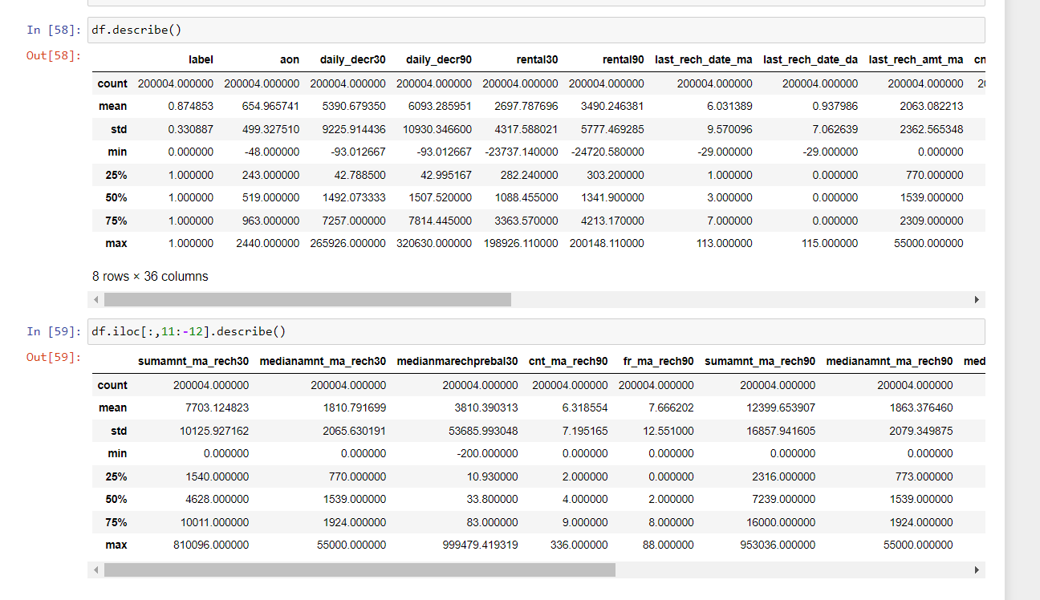
4) Summary Statistics
From this, we can see the data distribution that you have for each and determine whether there are outliers or not.
5) Check Duplicate values
In the dataset there are no duplicate we found.

Slide 5
The bar graph shows that the majority of people (176,707) have successfully repaid their loans, while only 25,314 are in default.
The bar graph indicates that the most common loan amount taken was 5, to be repaid as 6, with 173507 individuals taking out this loan. Additionally, 25360 people took out a loan of 10, to be repaid as 12. Lastly, there are 3154 individuals who did not take out a loan.

Slide 6
According to the bar graph, the most frequently borrowed loan amount was 5, with a repayment rate of 6. This loan amount was taken out by 173507 individuals. There were also 25360 individuals who borrowed 10 with a repayment rate of 12. Lastly, the graph shows that 3154 people did not borrow any loan at all.
The bar graph shows that the highest amount of loans were issued in the month of July with 82858, followed by June with 79890, and the least amount was issued in August with 39273.

Slide 7
The bar chart reveals that, based on the dataset, most people have only taken one loan within the past 30 days.
The graph illustrates that in July (month 7), the highest number of loans were taken and 84.92% of those loans were successfully repaid. June (month 6) had the second highest number of loans taken with 83.98% repayment success rate. Lastly, August (month 8) had the least number of loans taken but had a 100% repayment success rate.

Slide 8
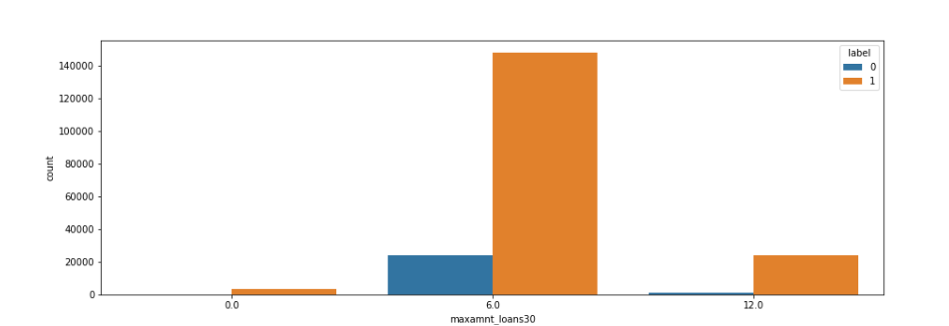
The bar chart above displays the maximum amount of loans taken by users in the last 30 days versus the repayment amounts. It can be seen that when the loan amount is 5 and the repayment amount is 6, 86.00% (171772) of individuals successfully repay their loan within 30 days. Similarly, when the loan amount is 10 and the repayment amount is 12, 96.07% (25117) of individuals successfully repay their loan within 30 days. Additionally, the chart indicates that 3115 people did not take any loan.
The bar chart above illustrates the maximum amount of loans taken by users in the last 90 days in relation to the repayment amounts. It can be seen that when the loan amount is 5 and the repayment amount is 6, 86.06% (172590) of users successfully repay their loans within 90 days. On the other hand, when the loan amount is 10 and the repayment amount is 12, 96.12% (25470) of users successfully repay their loans within 90 days. Additionally, the chart also indicates that 1944 people did not take any loan during this period.

Slide 9
The Set Of Assumptions Related To The Problem Under Consideration
1] For this particular problem I have dropped the unwanted columns which I feel like it is unwanted.
2]Identify and remove unrealistic data points by dropping any data points with a value greater than a certain threshold for each column.
3] For this particular problem I have assumed that the Maximum VIF should be 10, if any of the features has a VIF which is greater than 10 we should drop that feature.

Slide 10
Steps
1) First we identify null values and there were no null values present in dataset
2) Then I identified duplicates and there were no duplicates
3) Performed EDA and wrote all observations for each graph
4) Then i dropped unnecessary columns
5) Then also plotted the Distribution plot and regression plot
6) Then plotted boxplot to remove outliers
7) Then treated outliers with the Z-score method
8) Then scaled data and Also check for VIF
9) Then find the co-relation between feature and label by the CORR method
10) Then selected the top features by busing Selectkbest technique
11) Then created 4 models that is Logistic Regressor, Random Forest Regressor ,linear Regressor model, KNN Modelwith hyperparameter tuning for all 4 models and also Cross-validations
12) At last I selected the best model according to their CV score and Training(R2) and testing score(R2)

Slide 11
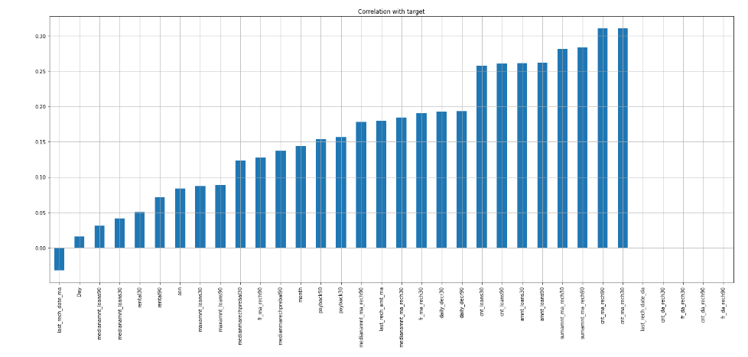
These are all the features that are positively co-related to the label and Negatively Co-related to the Label

Slide 12
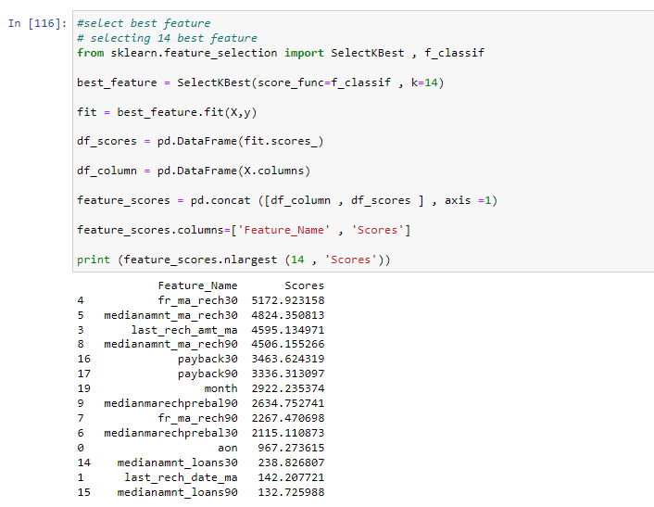
Selection Of top 20 features which will help more to predict our label
The top 20 Feature According to SelectKbest is fr_ma_rech30, medianamnt_ma_rech30, last_rech_amt_ma, medianamnt_ma_rech90, payback30,payback90, month, medianmarechprebal90, fr_ma_rech90, medianmarechprebal30 ,aon,medianamnt_loans30, last_rech_date_ma ,medianamnt_loans90

Slide 13
Testing of Identified Approaches (Algorithms)
➢ LR (Logistic Regression Model)
➢ DT (Decision Tree Classifier Model)
➢ RF (Random Forest Classifier Model)
➢ KNN (K-Nearest Neighbours Model)

Slide 14
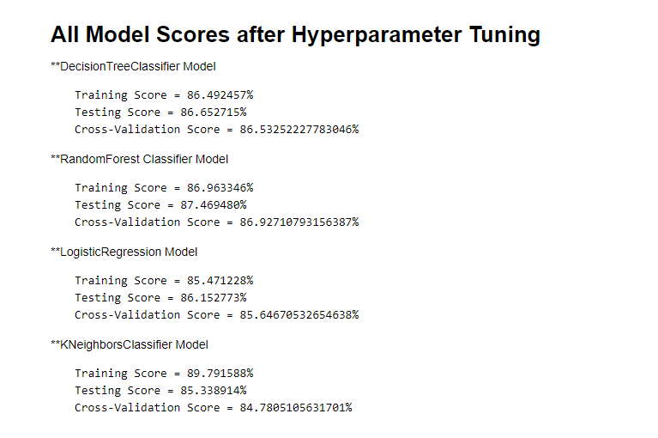
These are 4 Models Which I selected to predict the Micro loan Default model and after hyperparameter tuning, we Find that Random Forest Regressor Model is the best-suited model and so selecting Random Forest Regressor Model.

Slide 15
CONCLUSION
After tuning the hyperparameters, the Random Forest Classifier has been determined to be the best model for this problem, as it has a training score of 87% and a testing score of 87% according to the AUC-ROC curve.

